Slide 1
International Conference on
Computational Science and Applications (ICCSA21)
MIT-WPU
PID 7
MetaEfficientNet: A Few Shot Learning Approach for Lung Disease Classification

Slide 2
CONTENT
Title
Abstract
Evaluation of Related research
Background
Proposed Model for Classification of lung disease
Mathematical Background
Results & Discussion
Conclusion
References

Slide 3
TITLE
MetaEfficientNet
A Few Shot Learning Approach for Lung Disease Classification

Slide 4
ABSTRACT
Medical image diagnosing has been tremendously improved by making use of machine learning and deep learning algorithms in the last few decades. These algorithms have achieved human-like precision and accuracy in terms of identifying and distinguishing ailments particularly Lung related. This human-like accuracy comes at the cost of data. Conventional machine learning and deep learning methods achieve higher accuracy with vast amounts of data and their accuracy plummets when either there is data scarcity or data imbalance. To prevail over this issue we make use of Siamese net which is a metric spaced meta learning algorithm. Meta-learning mimics the idea of human learning from a minimal amount of data. Few-shot learning gains an upper hand over traditional algorithms by making use of a nominal amount of data. Using this approach we proposed the MetaEfficientNet and for the purpose of comparison, we used the CNN and VGG-16 based Siamese network as the baseline models. The proposed model achieved an AUC score of 0.9734 and accuracy of 97% which was best among the three models. Also, our proposed model achieved an accuracy score of 98% with a 3-way-8-shot approach and gave above 75% on newly given classes of lung diseases as well with a 6-way-8-shot learning approach.

Slide 5
OBJECTIVE
Collection of Datasets
Analyzing correlation
Build and train similarity model
Propose a novel architecture which is efficient & delivers good results on meager amount of data
Making sure the novel method is feasible and practical

Slide 6
RELATED RESEARCH

Slide 7
Ref | Paper Title | Feature | Accuracy | Author | Comments
[25] | COVID-19 detection from scarce chest x-ray image data using few-shot deep learning approach. | Used Siamese nets | 96.4% | Shruti Jadon | They made use of embedded analysis and clustering approaches to reduce overfitting and regularize the effect of the model. However they noticed some caveats like general models used for classification might not work optimally and scarcity of data affects distribution.
[12] | MetaCOVID: A Siamese neural network framework with contrastive loss for n-shot diagnosis of COVID-19 patients | Used VGG16 encoder network In Siamese n shot learning | 95.6% | Mohammad Shorfuzzaman M. Shamim Hossain | Used vgg16 as twin networks in the Siamese model with loss functions like contrastive and binary cross-entropy. The paper does not show the effectiveness of model on any different disease category other than covid and pneumonia.

Slide 8
BACKGROUND

Slide 9
TRADITIONAL v/s FEW SHOT LEARNING
Traditional Classification
During the training process, we require large number of images for each of the class.
If the network is trained only on the above 4 classes of images, then we cannot expect to test it on any other class.
Few shot learning:
We require only few training example for each class.
Small fraction of data is enough to train on a new class.

Slide 10
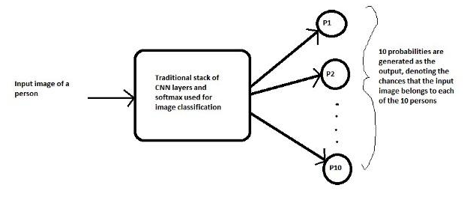
Real World Example: Face Recognition System

Slide 11
CHALLENGES
Require large amount of data for images of each person.
If a new person gets added.
If an old employee leaves the organization.
Training it all over again on new data.

Slide 12
FEW SHOT LEARNING APPROACH
Network is not learning to classify an image directly to any of the output classes. Rather, it is learning a similarity function, which takes two images as input and expresses how similar they are.
Image 1
Distance (similarity measure)
Siamese network
Image 2
loss function
Update weights

Slide 13
PROPOSED SYSTEM

Slide 14
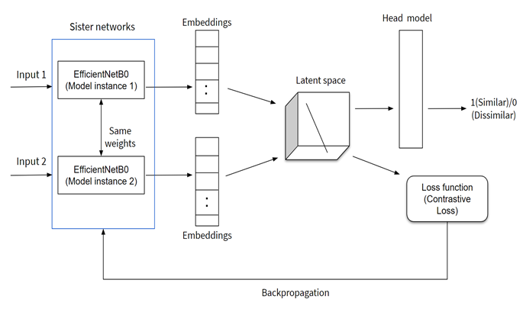
PROPOSED SYSTEM

Slide 15
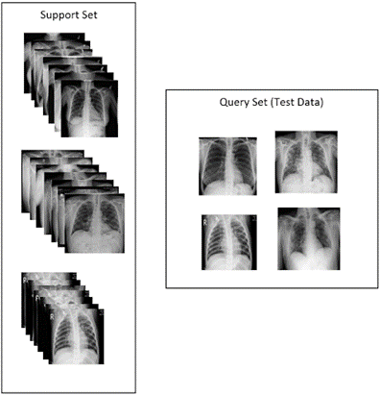
Generation of support set and Query Set
Support set:
the set of images which is used to compare against the incoming test image or query image
Query Set:
the test set which needs to be classified.

Slide 16
Learning
Learning in twin networks is done using Contrastive loss:
Y = the true label
D = Euclidean distance between two embeddings.

Slide 17
Algorithm
Input: Dataset D, Batch size N, Number of epochs nepochs, fine-tuned EfficientB0 model M with parameter p, Head model H, Loss L, margin m
Initialize: img1, img2, image_pairs, true_similarity_label, predicted_similarity, dist for training
image_pairs, true_similarity_label = get_pairs(D)
p₀ = w₀
for i do nepochs
for b do getBatches()
img1, img2 = image_pairs
em1 = M(img1)
em2 = M(img2)
dist_{b} = euclidean((em1,em2))
predicted_similarity = head_model(dist_{b})
L_{b} = ContrastiveLoss(predicted_similarity, true_similarity_label,m)
Update parameter p_{b} with new weight, w
end for
end for

Slide 18
RESULTS

Slide 19
Observation
Model | Accuracy
MetaCovid 3-way-10-Shot [Mohammad Shorfuzzaman et al.] | 96.5%
Siamese + DenseNet121 [Shruti Jadon et al.] | 96.4 %
MetaEfficientNet (3-way-8-shot) | 97.23 %

Slide 20
MetaEfficientNet: 6-way-8-shot learning on new classes
Disease | Accuracy
Cardiomegaly | 0.77
Effusion | 0.775
Fibrosis | 0.78
Infiltration | 0.66
Pneumothorax | 0.76
Pneumonia | 0.75

Slide 21
MetaEfficientNet : 6-way-k-shot for predicting new classes
Model | Cardiomegaly | Effusion | Fibrosis | Infiltration | Pneumothorax | Pneumonia
6-way-6-shot | 83 | 80 | 83.5 | 76.5 | 83.5 | 83
6-way-11-shot | 77.5 | 75.5 | 77.5 | 76 | 70 | 76.5
6-way-13-shot | 96.5 | 83.5 | 81.5 | 76.5 | 85 | 88

Slide 22
Conclusion
Lung diseases are still among the most fatal diseases in the world. In 2020 we saw how COVID-19 was able to bring an entire planet to a halt. Current diagnostic tools, albeit accurate, are not very efficient and cheap. Conventional methods of machine learning and deep learning have set impressive benchmarks but at the cost of the requirement of immense data. In this paper, we have successfully proposed a MetaEfficientNet model for the Chest X-ray image classification. We performed a comparative analysis between our proposed model and baseline model CNN and VGG-16, our proposed model successfully achieved an accuracy of 97%. The experimentation results revealed that the MetaEfficientNet for 3-way-8-shot learning worked better than the state-of-the-art models. Moreover, when introduced with few samples of new classes of lung diseases, the 6 way-8-shot model gave comparable accuracies and performed significantly well on the unseen data of new classes. Thus our proposed model, with just a small fraction of data is capable of producing good results. Additionally this few shot learning approach can also be extended to other categories of diseases like cancer or tumors using CT scan data.

Slide 23
References

Slide 24
1. Forum of International Respiratory Societies. The Global Impact of Respiratory Disease – Second Edition. Sheffield, European Respiratory Society, 2017.
2. Hwang, E.J.; Park, S.; Jin, K.N.; Kim, J.I.; Choi, S.Y.; Lee, J.H.; Goo, J.M.; Aum, J.; Yim, J.J.; Park, C.M. Development and Validation of a Deep Learning—based Automatic Detection Algorithm for Active Pulmonary Tuberculosis on Chest Radiographs. Clin. Infect. Dis. 2019, 69, 739–747.
3. Tobias, R.R.; De Jesus, L.C.M.; Mital, M.E.G.; Lauguico, S.C.; Guillermo, M.A.; Sybingco, E.; Bandala, A.A.;Dadios, E.P. CNN-based Deep Learning Model for Chest X-ray Health Classification Using TensorFlow. InProceedings of the 2020 RIVF International Conference on Computing and Communication Technologies, RIVF 2020, Ho Chi Minh, Vietnam, 14–15 October 2020 .
4. Ahsan, M.M.; Alam, T.E.; Trafalis, T.; Huebner, P. Deep MLP-CNN model using mixed-data to distinguish between COVID-19 and Non-COVID-19 patients. Symmetry 2020, 12.
5. Kieu STH, Bade A, Hijazi MHA, Kolivand H. A Survey of Deep Learning for Lung Disease Detection on Medical Images: State-of-the-Art, Taxonomy, Issues and Future Directions. Journal of Imaging. 2020; 6(12):131. https://doi.org/10.3390/jimaging6120131
6. Hashmi MF, Katiyar S, Keskar AG, Bokde ND, Geem ZW. Efficient Pneumonia Detection in Chest X-RAY Images Using Deep Transfer Learning. Diagnostics (Basel). 2020;10(6):417. Published 2020 Jun 19. doi:10.3390/diagnostics10060417.
7. S. V. Militante, N. V. Dionisio and B. G. Sibbaluca, "Pneumonia Detection through Adaptive Deep Learning Models of Convolutional Neural Networks," 2020 11th IEEE Control and System Graduate Research Colloquium (ICSGRC), Shah Alam, Malaysia, 2020, pp. 88-93, doi: 10.1109/ICSGRC49013.2020.9232613.
8. Ahsan, Mostofa & Gomes, Rahul & Denton, Anne. (2019). Application of a Convolutional Neural Network using transfer learning for tuberculosis detection. 427-433. 10.1109/EIT.2019.8833768.
9. Sudharsan Ravichandiran, Hands-On Meta Learning with Python, edited by Pavan Ramchandani, et al., Packt Publishing Ltd, December 2018, www.packtpub.com
10. Jadon, S. (2020). An Overview of Deep Learning Architectures in Few-Shot Learning Domain. ArXiv, abs/2008.06365
11. Li, M.D., Chang, K., Bearce, B. et al. Siamese neural networks for continuous disease severity evaluation and change detection in medical imaging. npj Digit. Med. 3, 48 (2020). https://doi.org/10.1038/s41746-020-0255-1
12. Mohammad Shorfuzzaman, M. Shamim Hossain, MetaCOVID: A Siamese neural network framework with contrastive loss for n-shot diagnosis of COVID-19 patients, Pattern Recognition, Volume 113, 2021, 107700, ISSN 0031-3203, https://doi.org/10.1016/j.patcog.2020.107700.

Slide 25
13. K. Prayogo, A. Suryadibraya, and J. Young, “Classification of pneumonia from x-ray images using siamese convolutional network,” Telkomnika (Telecommunication Computing Electronics and Control), vol. 18, no. 3, pp. 1302–1309, 2020.
14. M.E.H. Chowdhury, T. Rahman, A. Khandakar, R. Mazhar, M.A. Kadir, Z.B. Mahbub, K.R. Islam, M.S. Khan, A. Iqbal, N. Al-Emadi, M.B.I. Reaz, M. T. Islam, “Can AI help in screening Viral and COVID-19 pneumonia?” IEEE Access, Vol. 8, 2020, pp. 132665 - 132676.
15. Kermany, Daniel; Zhang, Kang; Goldbaum, Michael (2018), “Labeled Optical Coherence Tomography (OCT) and Chest X-Ray Images for Classification”, Mendeley Data, V2, doi: 10.17632/rscbjbr9sj.2
16. Hands-On Meta Learning with Python Meta learning using one-shot learning, MAML, Reptile, and Meta-SGD with TensorFlow Sudharsan Ravichandiran
17. Simonyan, Karen & Zisserman, Andrew. (2014). Very Deep Convolutional Networks for Large-Scale Image Recognition. arXiv 1409.1556.
18. Sitaula, C., Hossain, M.B. Attention-based VGG-16 model for COVID-19 chest X-ray image classification. Appl Intell 51, 2850–2863 (2021). https://doi.org/10.1007/s10489-020-02055-x
19. Ibrahem Kandel, Mauro Castelli, The effect of batch size on the generalizability of the convolutional neural networks on a histopathology dataset, ICT Express, Volume 6, Issue 4, 2020, Pages 312-315, ISSN 2405-9595, https://doi.org/10.1016/j.icte.2020.04.010.
20. https://neurohive.io/en/popular-networks/vgg16/
21. Tan, Mingxing, and Quoc Le. "EfficientNet: Rethinking model scaling for convolutional neural networks." In International Conference on Machine Learning, pp. 6105-6114. PMLR, 2019.
22. Gonçalo Marques, Deevyankar Agarwal, Isabel de la Torre Díez, Automated medical diagnosis of COVID-19 through EfficientNet convolutional neural network, Applied Soft Computing, Volume 96, 2020, 106691, ISSN 1568-4946, https://doi.org/10.1016/j.asoc.2020.106691.
23. Linh T. Duong, Phuong T. Nguyen, Claudio Di Sipio, Davide Di Ruscio, Automated fruit recognition using EfficientNet and MixNet, Computers and Electronics in Agriculture, Volume 171, 2020, 105326, ISSN 0168-1699, https://doi.org/10.1016/j.compag.2020.105326.
24. Putra, Tryan & Rufaida, Syahidah & Leu, Jenq-Shiou. (2020). Enhanced Skin Condition Prediction Through Machine Learning Using Dynamic Training and Testing Augmentation. IEEE Access. PP. 1-1. 10.1109/ACCESS.2020.2976045.
25. Jadon, Shruti. (2021). COVID-19 detection from scarce chest x-ray image data using few-shot deep learning approach. 1. 10.1117/12.2581496.

Slide 26
THANK YOU

